Slide 1
Interim method to print NALCOMIS High Priority NMCS/PMCS Report

Slide 2
NMCS/PMCS REPORT
The print indicator for the High Priority NMCS/PMCS Report has been set to null.
The batch job will still need to be processed from the Job Queue
In order to print the High Priority NMCS/PMCS Report utilize either of the following methods (Print Server Report or File Transfer)

Slide 3
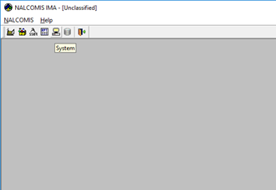
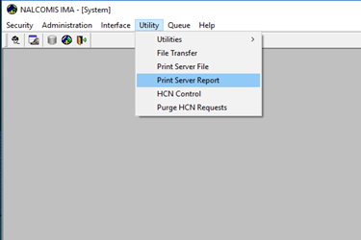
Print Server Report Method
Step 1: Navigate to System > Utility > Print Server Report

Slide 4
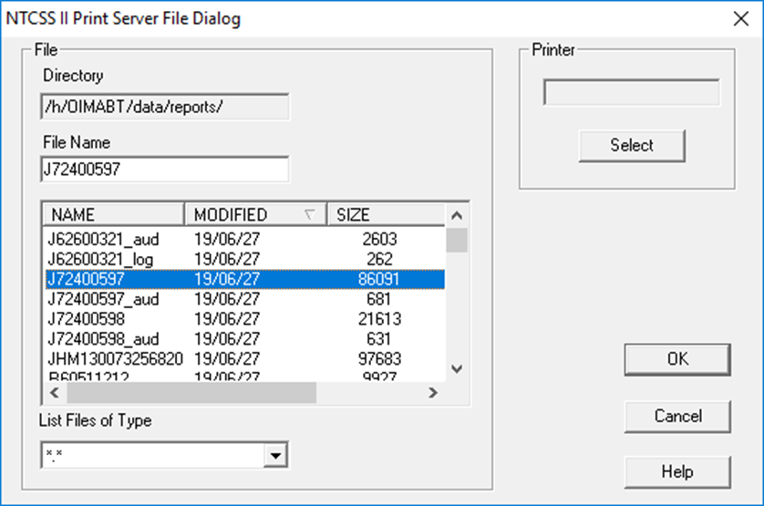
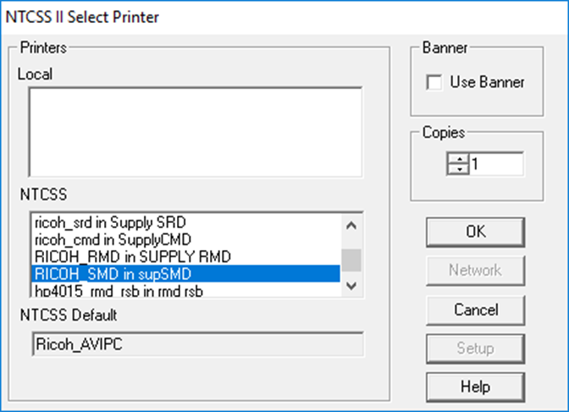
Print Server Report Method
2
3
4
2
5
Step 2: Type the Job ID J72400### for the File Name and continue to Step 3
or
Use the scroll bar to locate and select the Job ID and then continue to Step 3
Step 3: In the Printer group Click the “Select” button to select a Printer
Step 4: Use the scroll bar to locate the NTCSS Printer you wish to print to
Step 5: Click “Ok”

Slide 5
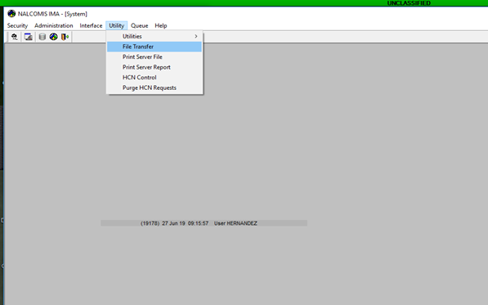
File Transfer Method
Step 1: Navigate to System > Utility > File Transfer

Slide 6
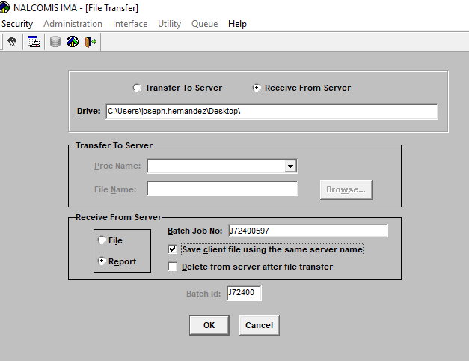
File Transfer Method
Select the Receive From Server Radio Button
Enter the destination path (location you want the file transferred to)
Select the Report Radio Button
Enter the Job ID
Check the Save client file using same server name box
Click “OK”
1
2
4
3
5
6

Slide 7
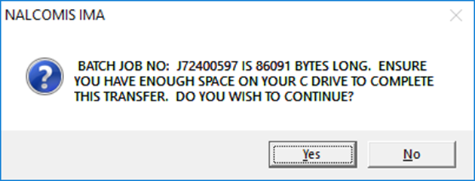
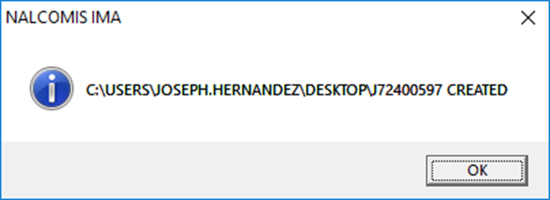
File Transfer Method
Select “Yes” on the first pop up window
Select “Ok” on the next pop up window

Slide 8
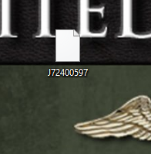

File Transfer Method
Select “Yes” on the first pop up window
Select “Ok” on the next pop up window
Locate the file and convert it to a .txt file by renaming it and adding .txt to the file name
Once converted, open text file and print as needed
If you can’t view or edit the file extension, Continue to the next slide

Slide 9

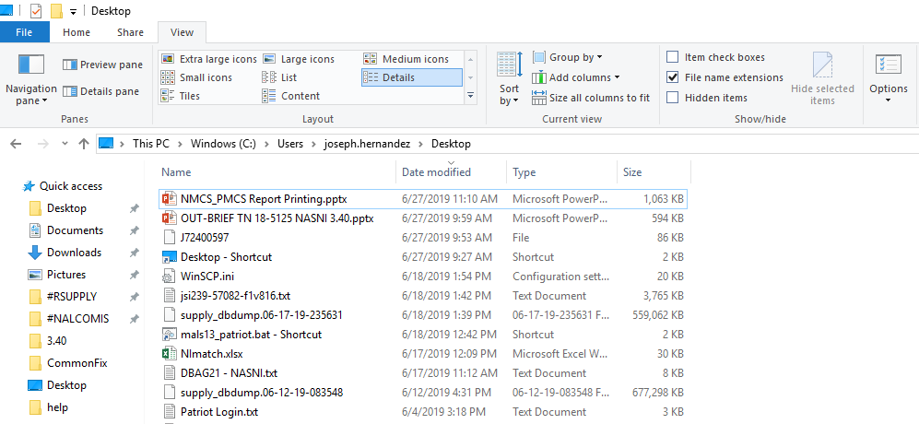
Enabling File Extensions
Select the File Explorer Icon from the Taskbar
Click on the “View” Tab
Check the “File name extensions” box
File Extensions will now be visible for all files
1
2
3

